Slide 1
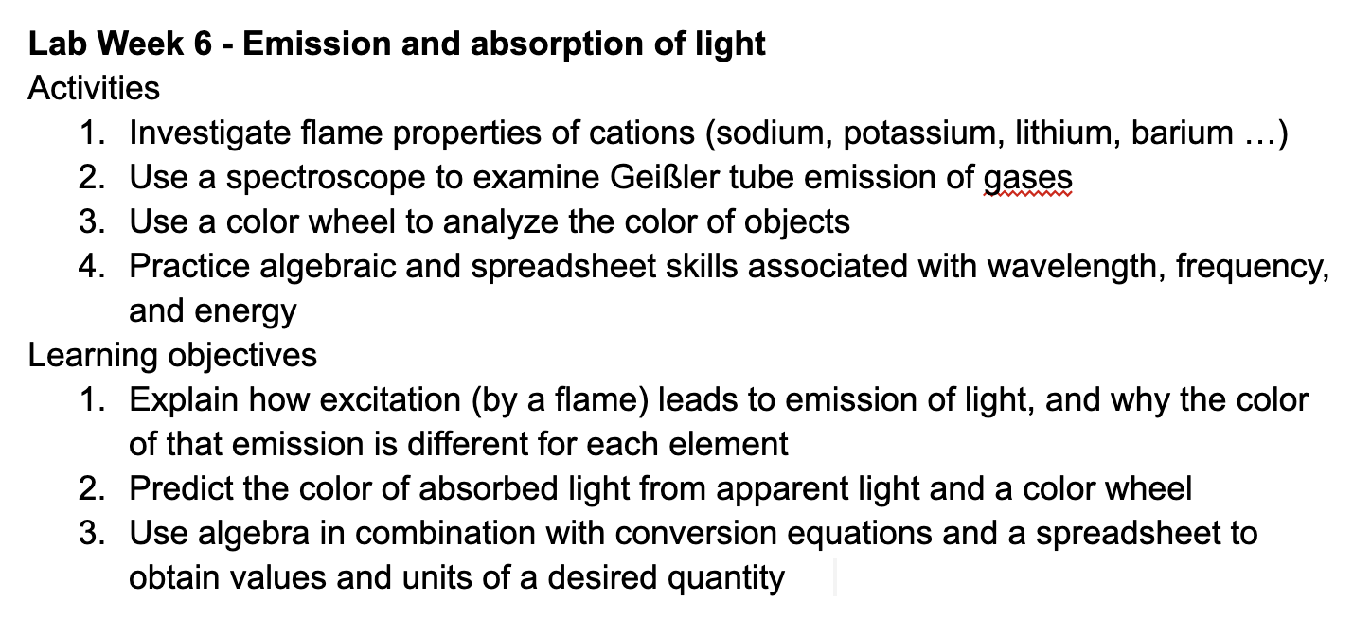
Lab this week

Slide 2
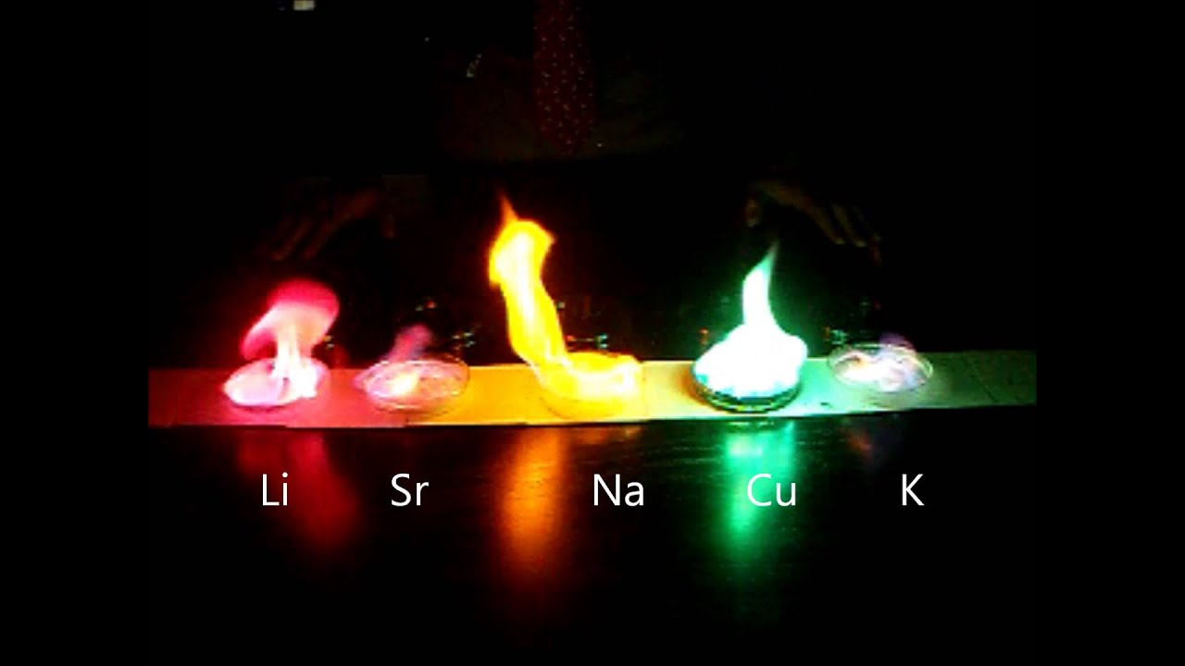

Parts 1 & 2. Spectroscopic investigation of flames and Geißler tubes
Metals have characteristic colors
The yellow we see in ordinary flames
is due to Na⁺ (sodium) ions

Slide 3



Parts 1 & 2. Spectroscopic investigation of flames and Geißler tubes
So do gases
This is a Geißler tube
We’ll use spectroscopes
to examine wavelength and energy of emitted light from both
Metals have characteristic colors

Slide 4
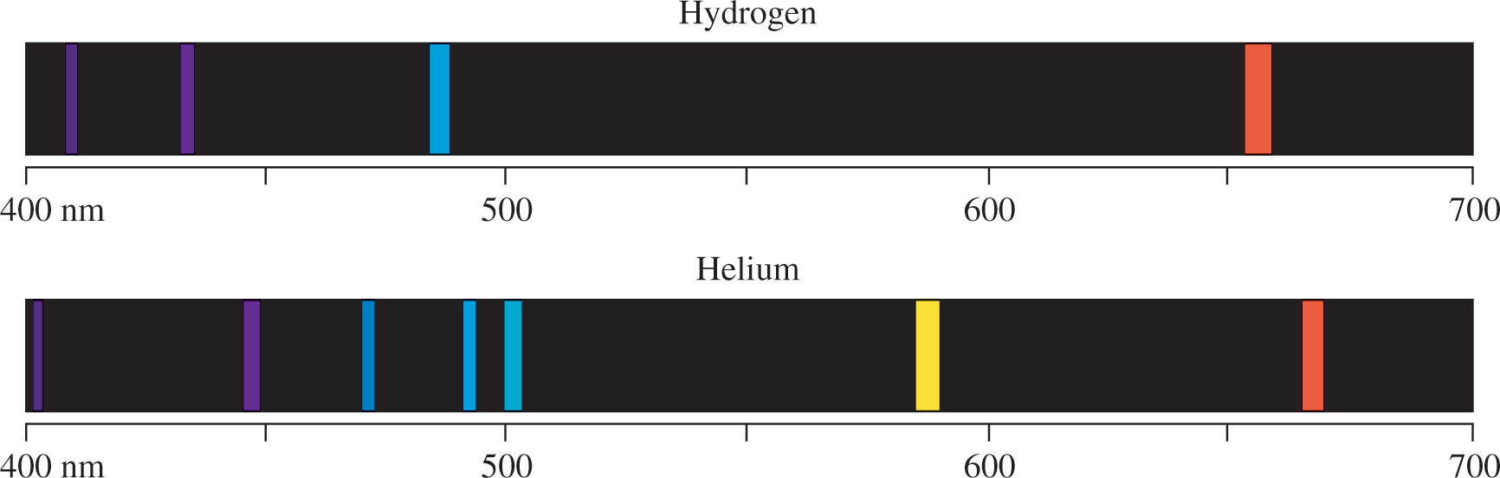
Parts 1 & 2. Spectroscopic investigation of flames and Geißler tubes
What do you see in a spectroscope?

Slide 5

Parts 1 & 2. Spectroscopic investigation of flames and Geißler tubes
What do you see in a spectroscope?
Sodium’s yellow doublet

Slide 6
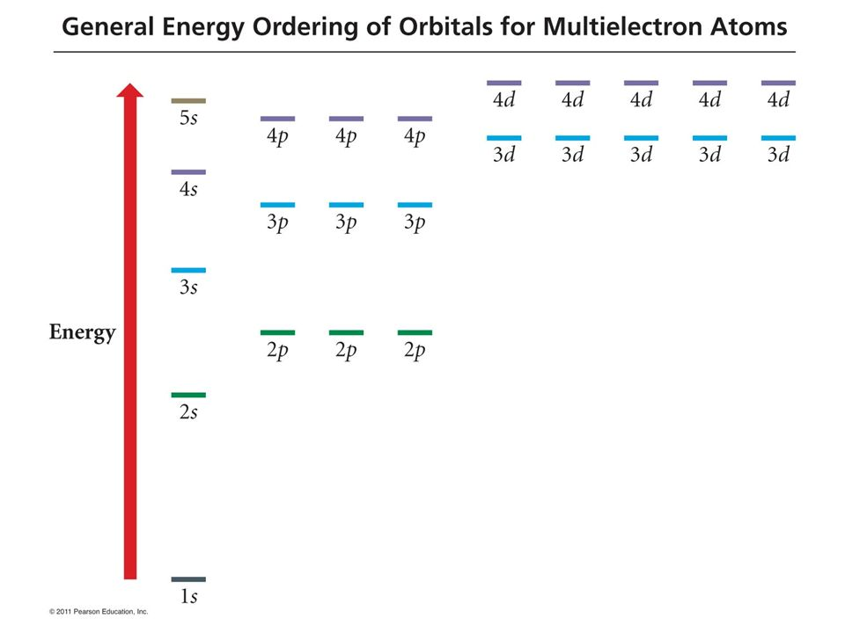
Parts 1 & 2. Spectroscopic investigation of flames and Geißler tubes
What do you see in a spectroscope?
Sodium’s yellow doublet

Slide 7
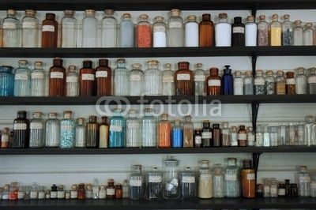
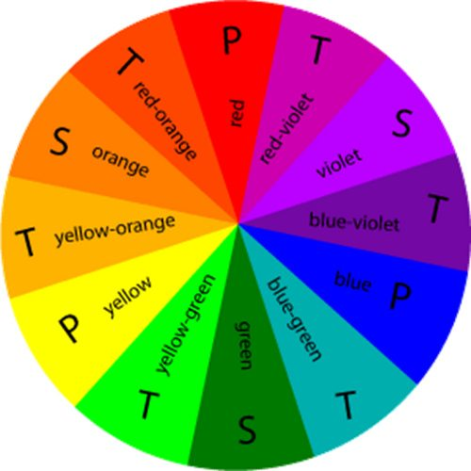
Part 3. Using the color wheel
1.8 eV
2.1 eV
3.6 eV
3.3 eV
2.4 eV
What wavelength of light is reflected?
What wavelength of light is absorbed?
2.7 eV
3.0 eV

Slide 8
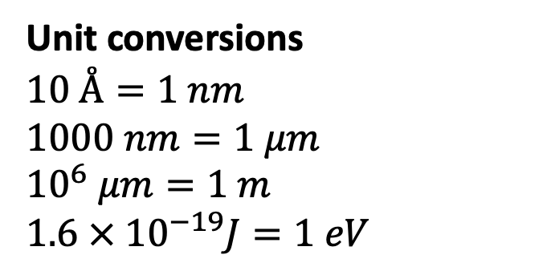

Part 4. Practicing algebraic and spreadsheet skills
1. Unit conversions and algebraic relationships
Unit conversions
$$10 Å=1 nm$$
$$1000 nm=1 μm$$
$$10^{6} μm=1 m$$
$$1.6 × 10^{−19}J=1 eV$$
Algebraic relationships
$$ν=\frac{c}{λ}$$
$$E_{photon}=hν$$
$λ_{max} =\frac{k}{T}$ (Wien’s Law)

Slide 9
Part 4. Practicing algebraic and spreadsheet skills
1. Unit conversions and algebraic relationships
Unit conversions
$$10 Å=1 nm$$
$$1000 nm=1 μm$$
$$10^{6} μm=1 m$$
$$1.6 × 10^{−19}J=1 eV$$
Algebraic relationships
$$ν=\frac{c}{λ}$$
$$E_{photon}=hν$$
$λ_{max} =\frac{k}{T}$ (Wien’s Law)

Slide 10
Part 4. Practicing algebraic and spreadsheet skills
1. Unit conversions and algebraic relationships
Unit conversions
$$10 Å=1 nm$$
$$1000 nm=1 μm$$
$$10^{6} μm=1 m$$
$$1.6 × 10^{−19}J=1 eV$$
Algebraic relationships
$$ν=\frac{c}{λ}$$
$$E_{photon}=hν$$
$λ_{max} =\frac{k}{T}$ (Wien’s Law)

Slide 11
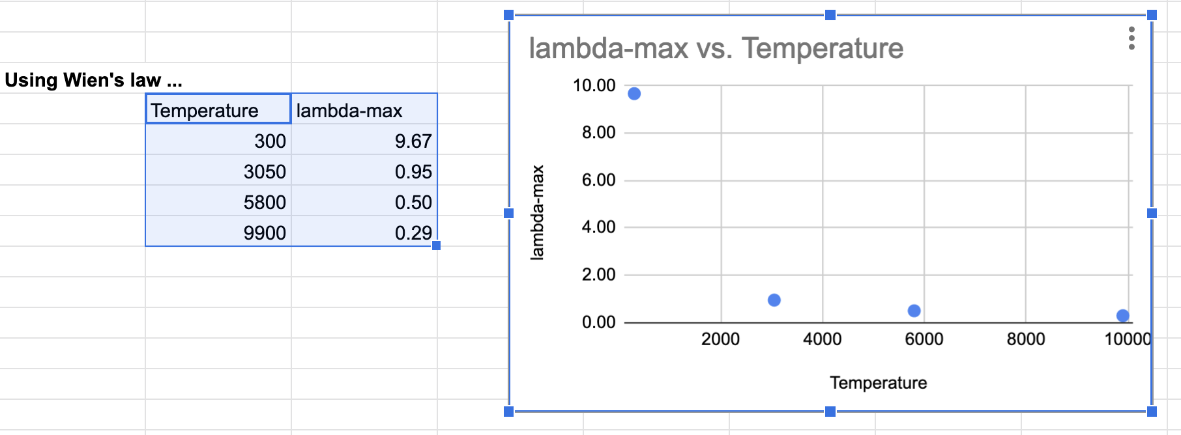
Part 4. Practicing algebraic and spreadsheet skills
2. Graphing
Unit conversions
$$10 Å=1 nm$$
$$1000 nm=1 μm$$
$$10^{6} μm=1 m$$
$$1.6 × 10^{−19}J=1 eV$$
Algebraic relationships
$$ν=\frac{c}{λ}$$
$$E_{photon}=hν$$
$λ_{max} =\frac{k}{T}$ (Wien’s Law)

